Slide 1

SPACE X PROJECT MISSION
Shaula M. Marquez
December 25, 2024

Slide 2

Table of Context
Executive Summary
Introduction
Methodology
Results
Conclusion
Appendix

Slide 3
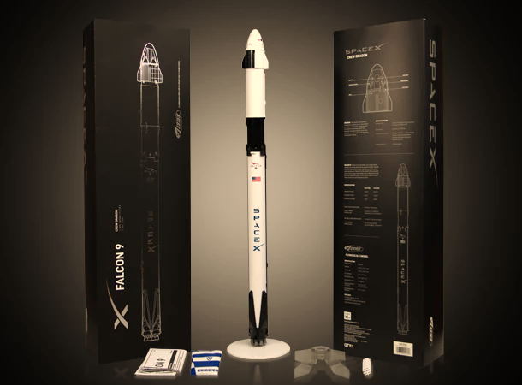
Executive Summary
Space Y would like to compete with SpaceX founded by Billionaire industrialist Allon Musk.
SpaceX advertises Falcon 9 rocket launches on its website, with a cost of 62 million dollars; other providers cost upward of 165 million dollars each, much of the savings is because SpaceX can reuse the first stage.
This information can be used if an alternate company wants to bid against SpaceX for a rocket launch.
The launch success rate may depend on many factors such as payload mass, orbit type, and so on. It may also depend on the location and proximities of a launch site, i.e., the initial position of rocket trajectories. Finding an optimal location for building a launch site certainly involves many factors and hopefully we could discover some of the factors by analyzing the existing launch site locations.

Slide 4

Introduction
This is an Applied Data Science Capstone Project by IBM in Coursera.
In this capstone, we will predict if the Falcon 9 first stage will land successfully.
SpaceX advertises Falcon 9 rocket launches on its website with a cost of 62 million dollars; other providers cost upward of 165 million dollars each, much of the savings is because SpaceX can reuse the first stage.
Therefore, if we can determine if the first stage will land, we can determine the cost of a launch. This information can be used if an alternate company wants to bid against SpaceX for a rocket launch.

Slide 5
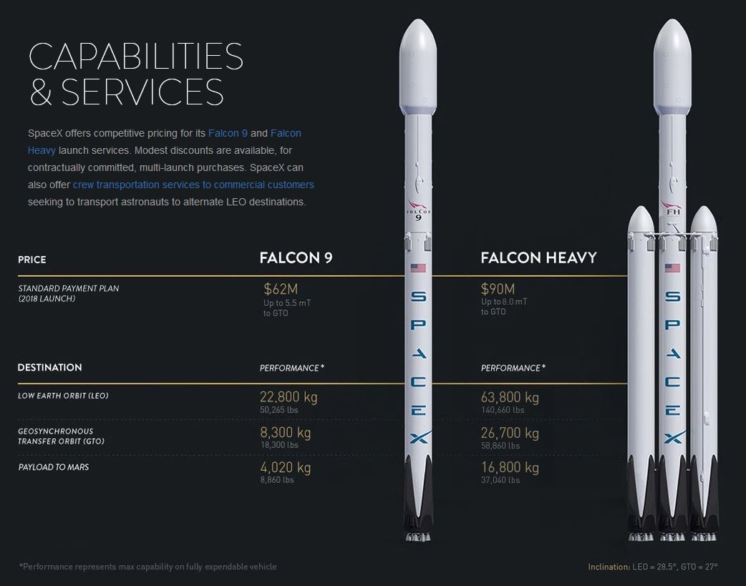
mETHODOLOGY
Data Collection
API
Request and parse the SpaceX launch data using the GET request
Filter the data frame to only include Falcon 9 launches
Dealing with Missing Values by replacing it with mean values for PayloadMass
Web Scraping
Request the Falcon9 Launch Wiki page from its URL
Extract all column/variable names from HTML table header
Create a data frame by parsing the launch HTML tables

Slide 6
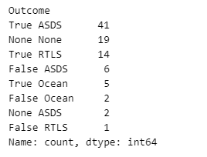
mETHODOLOGY
Data Wrangling
Calculate the number of launches
The data contains several SpaceX: Cape Canaveral Space Launch Complex 40 VAFB SLC 4E, Vandenberg Air Force Base Space Launch Complex (SLC-4E), Kennedy Space Center Launch Complex 39A KSC LC 39A.
Calculate the number and occurrence of each orbit
Determine the number and occurrence of each orbit in the column Orbit.
Calculate the number and occurrence of mission outcome of the orbits
Determine the number of landing outcomes.
Create a landing outcome label from outcome column
This variable will represent the classification variable that represents the outcome of each launch. If the value is zero, the first stage did not land successfully; one means the first stage landed Successfully
Number of Landing outcomes

Slide 7
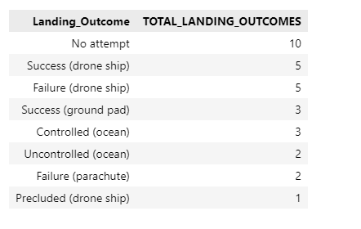
mETHODOLOGY
Exploratory Data Analysis (SQL)
Performed SQL queries:
Display the names of the unique launch sites in the space mission
Display records where launch sites begin with the string ‘CCA’
Display the total payload mass caried by boosters launched by NASA (CRS)
Display average payload mass carried booster version F9 v1.1
List the date when the first successful landing outcome in ground pad achieved
List the name of the boosters which have a success in drone ship and have payload mass greater than 4000 but less than 6000
List the total number of successful and failure mission outcomes
List the names of the booster versions which have carried the maximum payload mass.
List the records which will display the month names, failure landing outcomes in drone ship ,booster versions, launch site for the months in year 2015.
Rank the count of landing outcomes (such as Failure (drone ship) or Success (ground pad)) between the date 2010-06-04 and 2017-03-20, in descending order

Slide 8
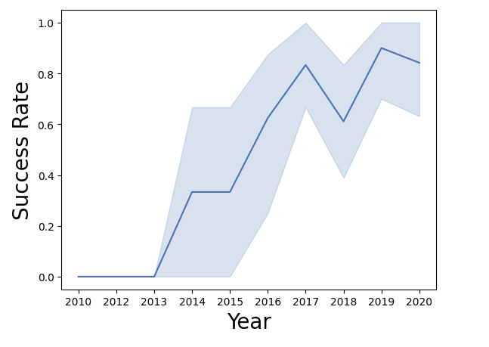
mETHODOLOGY
Exploratory Data Analysis (Visualization Lab)
Performed Exploratory Data Analysis and Feature Engineering using Pandas and Matplotlib
Visualized the relationship between Flight Number and Launch Site
Visualized the relationship between Payload and Launch Site
Visualized the relationship between success rate of each orbit type
Visualized the relationship between Flight Number and Orbit type
Visualized the relationship between Payload and Orbit type
Visualized the launch success yearly trend
Created dummy variables to categorical columns
Casted all numeric columns to `float64`

Slide 9
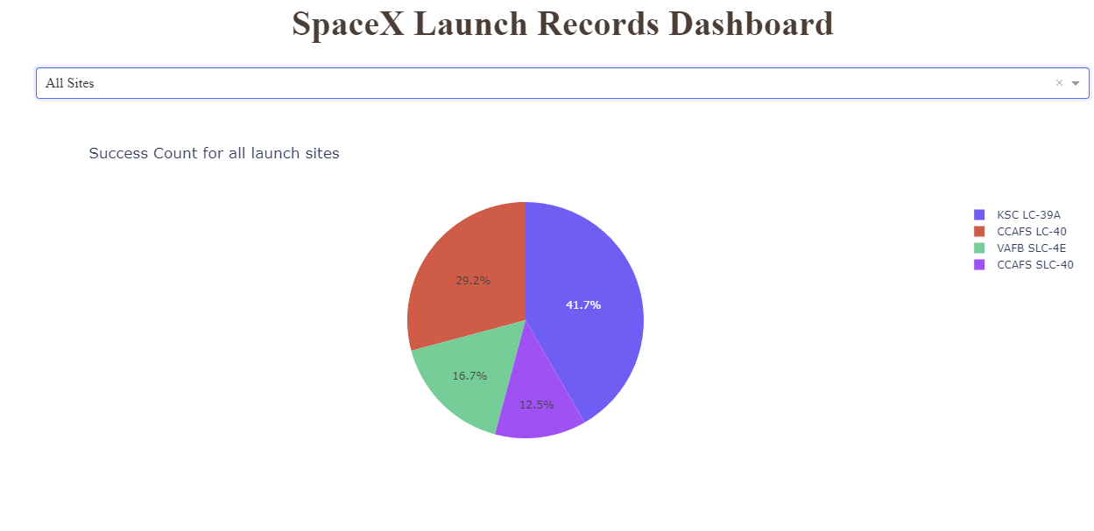
mETHODOLOGY
Interactive Dashboard with Ploty Dash
Built a Plotly Dash application for users to perform interactive visual analytics on SpaceX launch data in real-time.
This dashboard application contains input components such as a dropdown list and a range slider to interact with a pie chart and a scatter point chart. You will be guided to build this dashboard application via the following tasks:
Added a Launch Site Drop-down Input Component
Added a callback function to render success-pie-chart based on selected site dropdown
Added a Range Slider to Select Payload
Added a callback function to render the success-payload-scatter-chart scatter plot

Slide 10
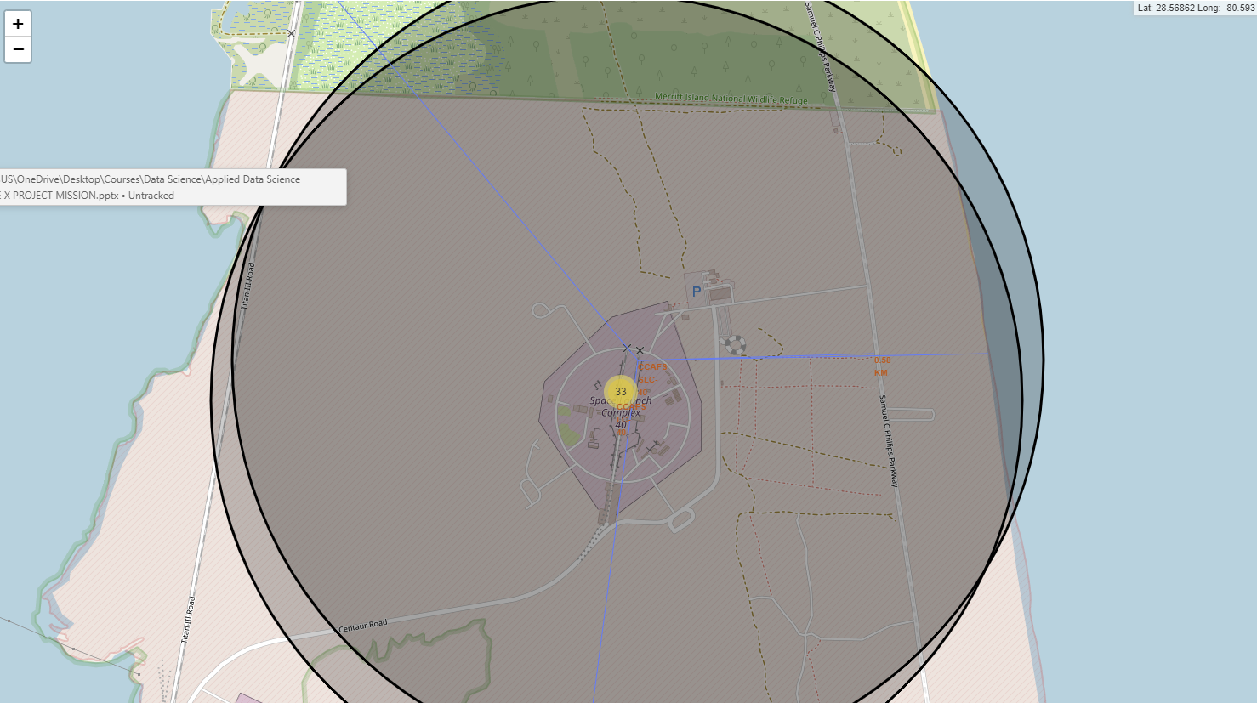
mETHODOLOGY
Interactive Visual Analytics with Folium
The launch success rate may depend on many factors such as payload mass, orbit type, and so on. It may also depend on the location and proximities of a launch site, i.e., the initial position of rocket trajectories. Finding an optimal location for building a launch site certainly involves many factors and hopefully we could discover some of the factors by analyzing the existing launch site locations.
Marked all launch sites on a map
Marked the success/failed launches for each site on the map
Calculated the distances between a launch site to its proximities

Slide 11
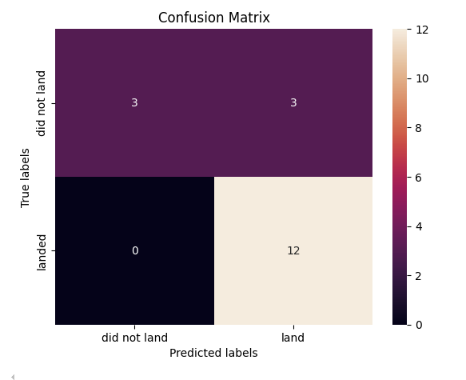
mETHODOLOGY
Predictive Analysis
Find the best method performs best using test data Hyperparameter for SVM, Classification Trees and Logistic Regression.
Imported the following libraries
Pandas
Numpy
Matplotlib
Seaborn
Sklearn
Loaded the data to the data frame
Created a NumPy array from the column in by applying the method to_numpy() then assign it to the variable, make sure the output is a Pandas series.
Standardized the data x then reassign it to the variable x using the transform provided below.
We split the data into training and testing data using the function.
Used the function train_test_split the data X and Y into training and test data.
Fit the training data to the following models:
logistic regression
Support Vector Machine
Decision Tree Classifier
K Nearest Neighbors Classifier

Slide 12
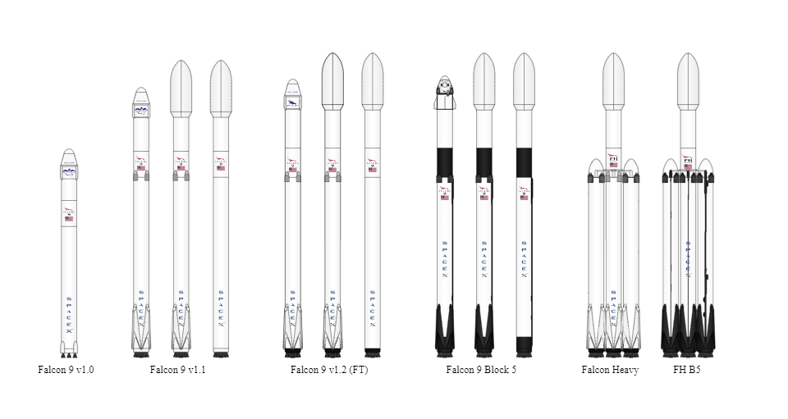
Results
Exploratory Data Analysis
Interactive Analytics Demo in Screenshots
Predictive Analysis Results

Slide 13

Exploratory Data Analysis With visualization

Slide 14
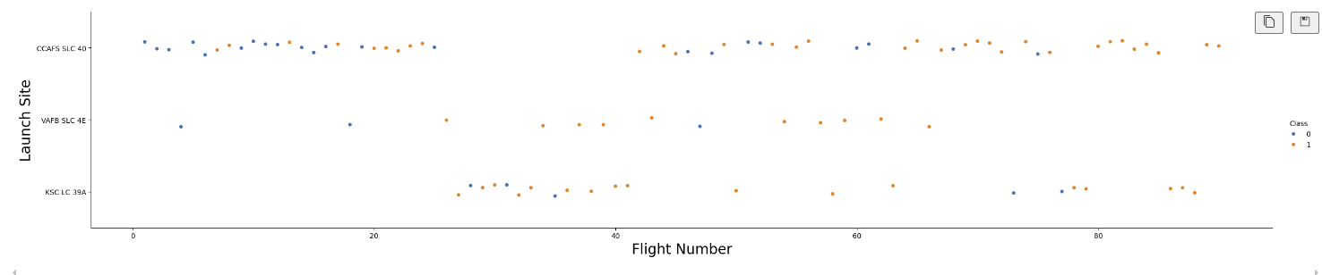
Results
Flight Number VS Launch Site
Early flights tend to have failure while later flights tend to succeed
Success seems to be consistent across multiple Launch Sites in later stages, reflecting overall improvement in operations and technology.
The results show a positive trend in flight success over time. This indicates learning and improvement, a hallmark of iterative advancements in aerospace engineering and operational processes.
Launch Site Variability: All launch sites show progress over time, though some (e.g., Kennedy Space Center) may have faced more initial challenges compared to others.

Slide 15
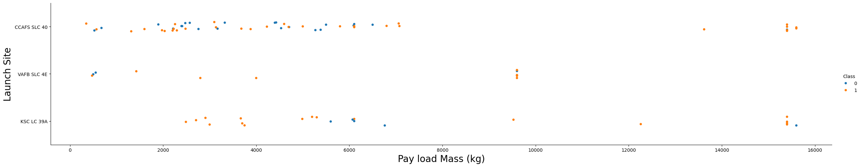
Results
Pay load Mass VS Launch Site
Success Rates Improve for Heavier Payloads: The likelihood of successful launches increases with payload mass, especially at CCAFS SLC 40 and KSC LC 39-A.
Launch Site-Specific Trends: Some sites (e.g., CCAFS SLC 40) manage more diverse payloads, while others (e.g., VAFB SLC 4E) appear to handle lighter payloads with mixed results.
Room for Improvement: The failures for lighter payloads might reflect early-stage missions or experimental technology.

Slide 16
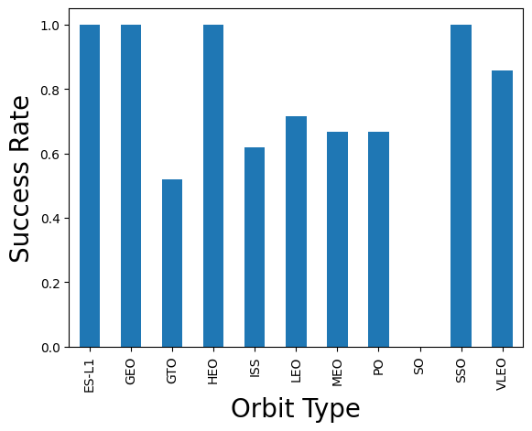
Results
High Success Rates (1.0): Orbits like ES-L1, GEO, LEO, and SSO have achieved a 100% success rate, indicating that all missions targeting these orbit types were successful.
Moderate to High Success Rates: VLEO (Very Low Earth Orbit) and PO (Polar Orbit) have a very high success rate close to 1.0 but slightly below.
Moderate Success Rates: HEO (Highly Elliptical Orbit) and ISS (International Space Station orbit) have a success rate slightly below 0.8, indicating that a significant majority of missions were successful.
Low Success Rate: GTO (Geostationary Transfer Orbit) stands out with a success rate below 0.6, suggesting challenges in achieving mission success for this orbit type.
Insights:
This chart could be used to assess the reliability and feasibility of space missions depending on the orbit type. The significantly lower success rate for GTO might indicate technical or operational challenges specific to this orbit.

Slide 17
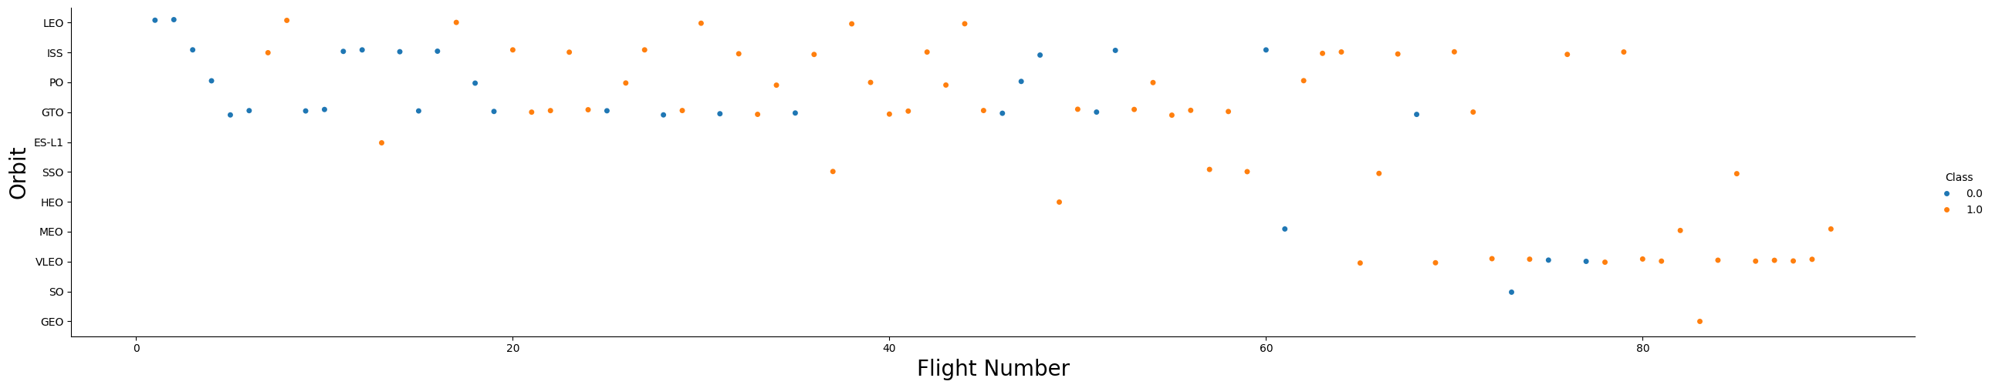
Results
Flight Number VS Orbit
As the flight number increases, there appears to be a higher proportion of orange dots (successes), suggesting improved mission success rates with experience or advancements in technology.
Early flight numbers (lower x-axis values) have more blue dots, particularly in orbits like GTO, indicating early challenges.
LEO (Low Earth Orbit): Consistently has a high number of successes (orange dots), indicating reliability in this orbit type. GTO (Geostationary Transfer Orbit): Shows a mix of failures and successes, with some improvement in success rates as flight numbers increase. SSO (Sun-Synchronous Orbit) and GEO (Geostationary Orbit): Fewer data points are available, but they tend to show success when attempted. PO (Polar Orbit) and ISS (International Space Station): Predominantly successful, especially for later flight numbers.
The data suggests a learning curve, where success rates improve as more flights are conducted (possibly due to better engineering, processes, or experience).

Slide 18
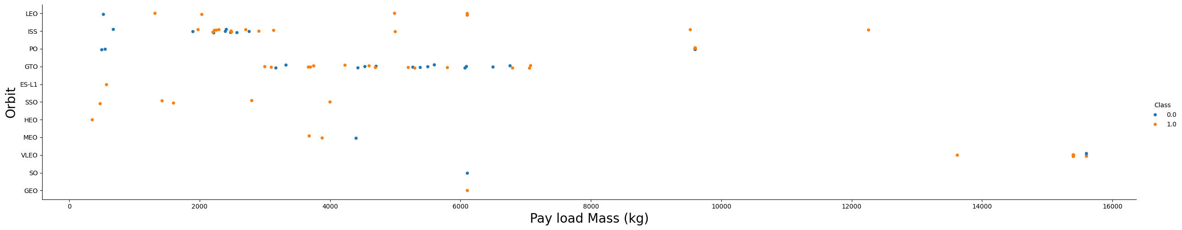
Results
Orbit VS Payload Mass
LEO (Low Earth Orbit): Can handle a wide range of payload masses (from light to very heavy) with a high success rate.
ISS (International Space Station orbit): Payloads targeting the ISS show high success, even for heavier payloads.
GTO (Geostationary Transfer Orbit): Has a mix of successes and failures across various payload masses. Notably, there are failures even at moderate payloads (2,000–6,000 kg).
SSO (Sun-Synchronous Orbit): Handles relatively lighter payloads, with a mix of successes and failures.
ES-L1 and HEO: Show fewer data points but indicate some challenges with success rates at varying payloads.
Heavier Payloads (>10,000 kg): Limited attempts (few dots), but some successful missions are visible, suggesting that heavier payloads are more challenging but achievable.
Payload Mass Impact: Heavier payloads increase the risk of mission failure, likely due to the complexity of launch dynamics.
Orbit Sensitivity: Certain orbits like LEO and ISS show robust performance across payload masses, while GTO appears more sensitive to payload mass.

Slide 19
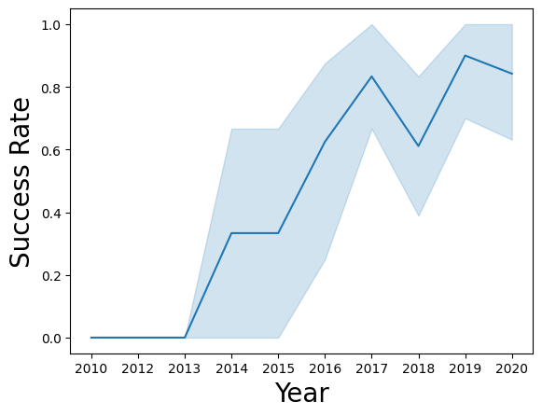
Results
Orbit VS Payload Mass
From 2013 the Success Rate increased until 2018 it decreased. Then it increased from 2019 onwards.

Slide 20
Exploratory Data Analysis With SQL

Slide 21
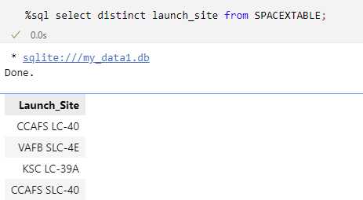
Results
Task 1
Display the names of the unique launch sites in the space mission

Slide 22
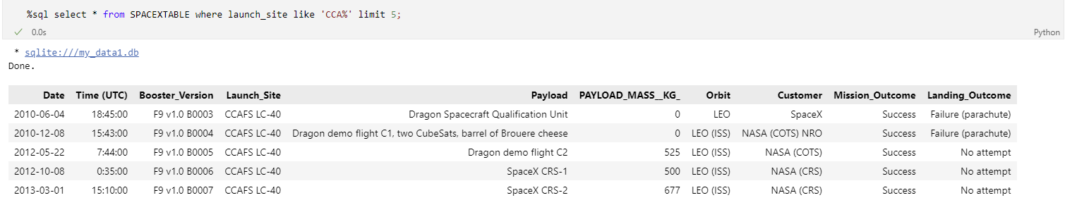
Results
Task 2
Display 5 records where launch sites begin with the string 'CCA'

Slide 23
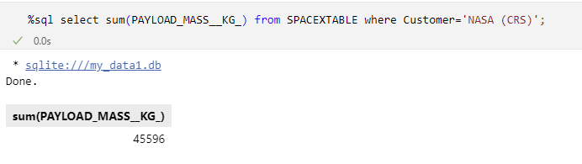
Results
Task 3
Display the total payload mass carried by boosters launched by NASA (CRS)

Slide 24
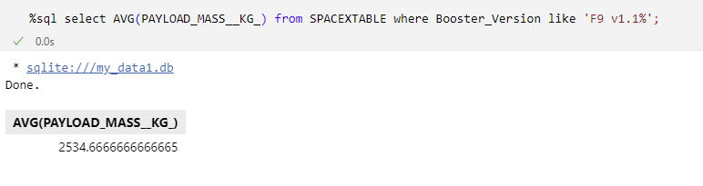
Results
Task 4
Display average payload mass carried by booster version F9 v1.1

Slide 25
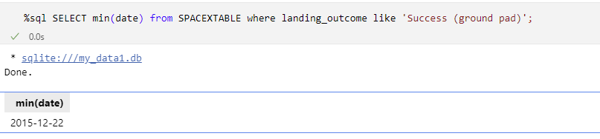
Results
Task 5
List the date when the first successful landing outcome in ground pad was achieved. average payload mass carried by booster version F9 v1.1

Slide 26
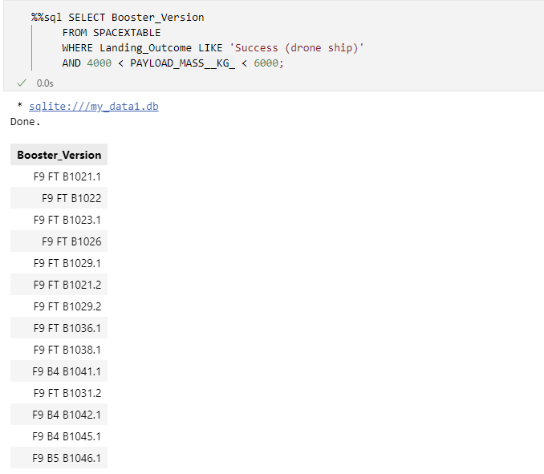
Results
Task 6
List the names of the boosters which have success in drone ship and have payload mass greater than 4000 but less than 6000

Slide 27
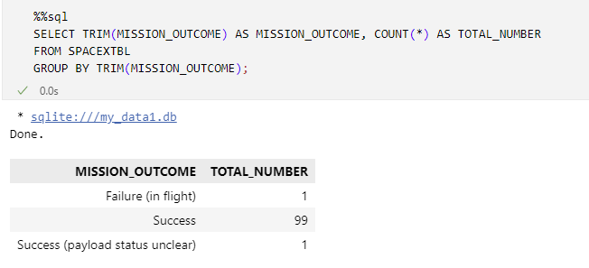
Results
Task 7
List the total number of successful and failure mission outcomes

Slide 28
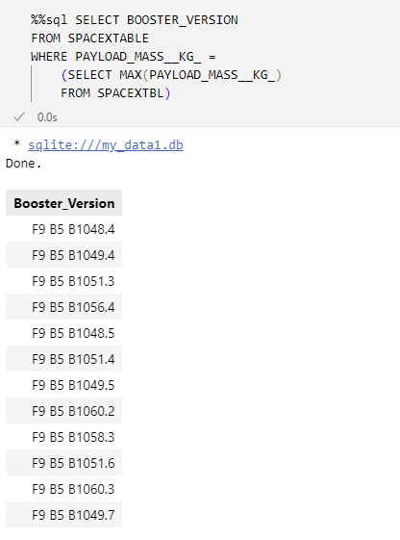
Results
Task 8
List the names of the booster_versions which have carried the maximum payload mass. Use a subquery

Slide 29
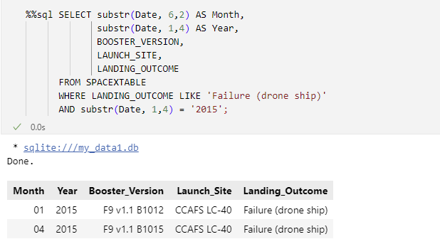
Results
Task 9
List the records which will display the month names, failure landing_outcomes in drone ship ,booster versions, launch_site for the months in year 2015.

Slide 30
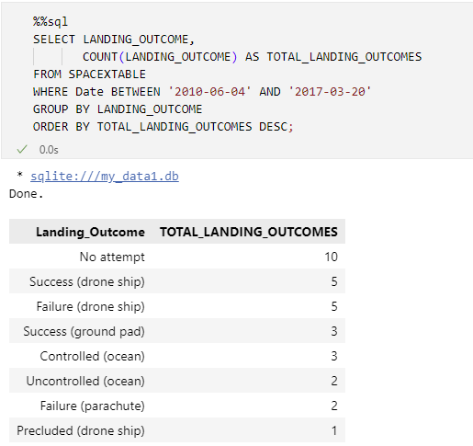
Results
Task 10
Rank the count of landing outcomes (such as Failure (drone ship) or Success (ground pad)) between the date 2010-06-04 and 2017-03-20, in descending order

Slide 31
Interactive map with folium

Slide 32

Results
The launch success rate may depend on many factors such as payload mass, orbit type, and so on. It may also depend on the location and proximities of a launch site, i.e., the initial position of rocket trajectories. Finding an optimal location for building a launch site certainly involves many factors and hopefully we could discover some of the factors by analyzing the existing launch site locations.
This lab contains the following tasks:
Mark all launch sites on a map
Mark the success/failed launches for each site on the map
Calculate the distances between a launch site to its proximities

Slide 33
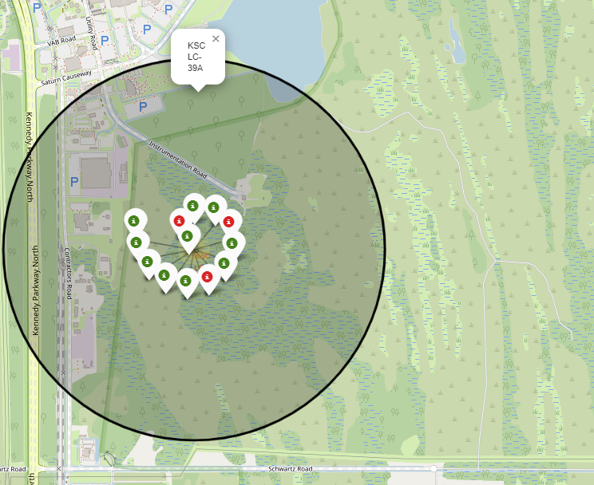
Results
We could see the successful rate of launch sites based on color markers on the map.
Green Marker – Successful
Red Marker – Failed Launch
KSC LC-39A has a successful launch rate.

Slide 34
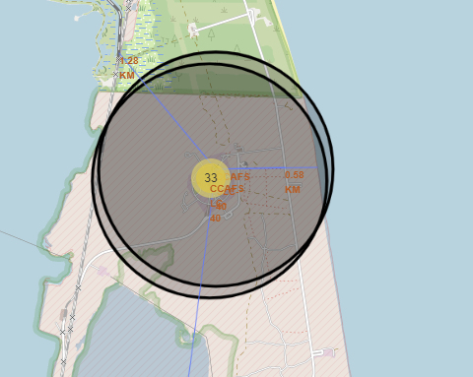
Results
Visualizing the railway, highway, coastline, and city proximities for each launch site allows us to see how close each is, for example:
Proximities for CCAFS SLC 40:
railway: 1.28 km
highway: 0.58 km
coastline: 0.86 km
city: 51.43 km

Slide 35
Build a Dashboard with Plotly dash

Slide 36
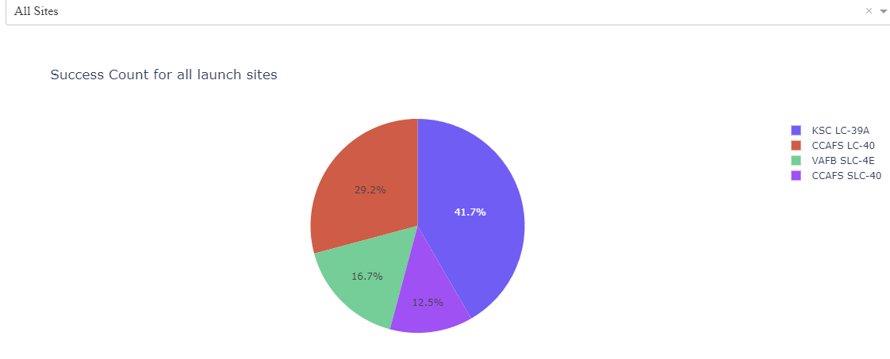
Results
Launch success count for all sites
The chart clearly shows that from all the sites, KSC LC-39A has the most
successful launches.

Slide 37
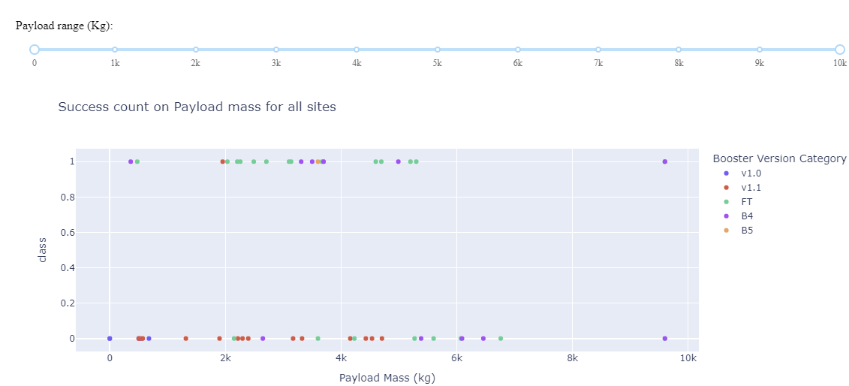
Results
Launch success count for all sites
Scatter plot showing Payload Mass VS Landing Outcome that are color coded by Booster Versions.

Slide 38
Predictive analysis (classification)

Slide 39
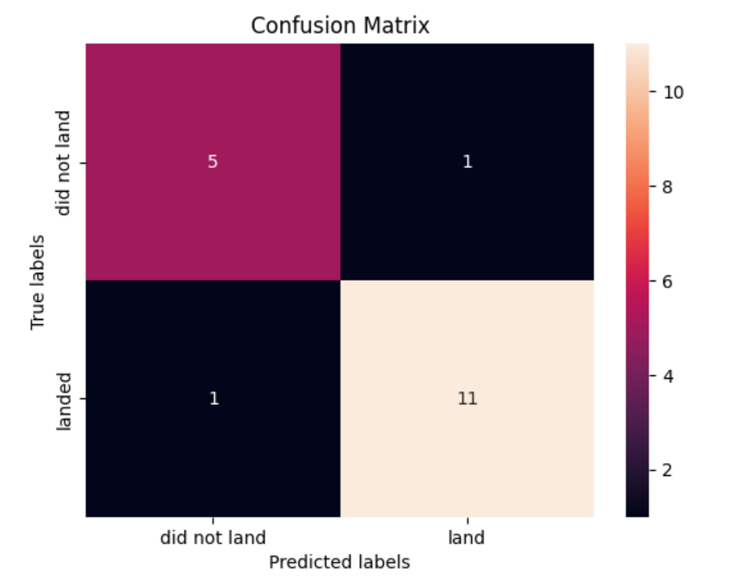
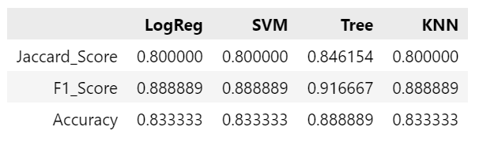
Results
Finding the Method Performs the Best
The best method to perform is definitely Decision Tree Method.
The model performs well, with high accuracy, precision, and recall, indicating it is effective at distinguishing between "landed" and "did not land" cases.

Slide 40

Conclusion
Decision Tree is the best model for the dataset with 88% accuracy.
The success rate of launches increased through the years.
KSC LC-39A has the highest success count with 41.7%.
Success rate with a low payload mass show better results than larger payload mass.
Orbits ES-L1, GEO, HEO and SSO have 100% success rate.

Slide 41

Appendix
All the analysis are found in my GitHub:
https://github.com/shaulamarquez/IBM-Data-Science
Acknowledgement
Thank you to Instructors, Coursera and IBM.

